Slide 1
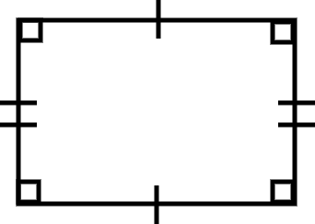
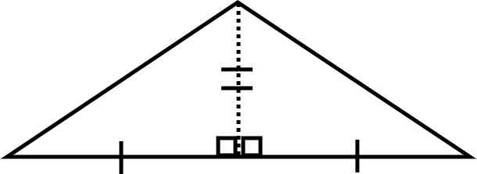
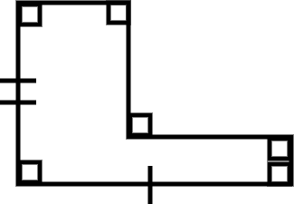
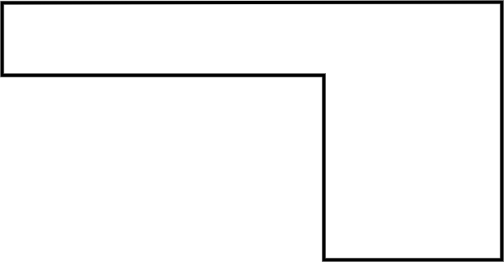
Area of composite rectilinear shapes
Task A: Comparing areas
1) Order the shapes from smallest to the largest area.
a) b) c)
C is the smallest as it fits inside A with space left over.
B can be split into two triangles along the dotted line and these can be rearrange to make A. Therefore B and A have the same area.
Task B: Three methods to find the area
1) Calculate the area of this composite rectilinear shape using each of the three methods.
Which is most efficient?
Justify your choice.
14 units
9 units
7 units
2 units
9 units
5 units

Slide 2
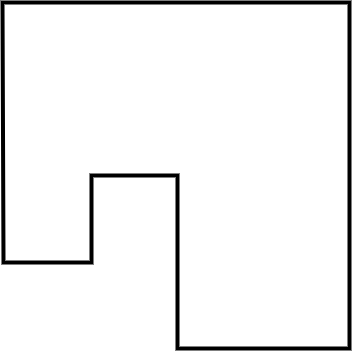
Area of composite rectilinear shapes
E.g.
Area = 2 × 9 + 5 × 9
Area = 18 + 45
Area = 63 units²
Area = 14 × 9 - 7 × 9
Area = 126 - 63
Area = 63 units²
Area = (2 + 5) × 9
Area = 7 × 9
Area = 63 units²
E.g. I think this method is the most efficient as it is the one I find the easiest to do. This method is easy to always do.
E.g. I think this method is the most efficient as it involves less work when the composite rectilinear shape is more complicated.
E.g. I think this method is the most efficient as it made just one rectangle that I had to find the area of.
Task C: Evaluating the methods
1) Draw your own composite rectilinear shape and try to find the area using the three methods.
Can you draw a shape where one (or more) of these methods would not be helpful?
Shapes will vary but should all be built from rectangles placed adjacent.
Here is an example of a shape where completing and rearranging are not as helpful.
Mathematics in Education and Industry.

